Slide 1

POINT CLOUD TECHNOLOGY
NAME: Alamin Sheikh Naim
ID:2013556642
NAME: Ahmed Sadman
ID:2014094042
NAME: Tawhid Islam
ID:2021499042
NAME: Muhaiminul Hassan Dihan
ID: 2111208642

Slide 2

A point cloud is a discrete set of data points in space. The points may represent a 3D shape or object. Each point position has its set of Cartesian coordinates (X, Y, Z). Points may contain data other than position such as RGB colors, normals, timestamps and others. Point clouds are generally produced by 3D scanners or by photogrammetry software, which measure many points on the external surfaces of objects around them.

Slide 3

PROBLEM STATEMENT
Point cloud processing is challenging due to irregularity, sparsity, and noise. This research introduces efficient, scalable methods using adaptive sampling, multi-scale feature extraction, and graph-based learning to enhance segmentation, classification, and object detection, improving 3D data analysis for various real-world applications.

Slide 4

SIGNIFICANCE
Point cloud data creates super-detailed 3D maps of places, like landscapes and buildings. It's like having a laser-powered ruler and protractor. Surveyors use it to measure distances, angles, and even volumes with mind-blowing accuracy. This helps in projects that need incredibly precise mapping.

Slide 5

Irregularity & Unstructured Data: Needs specialized algorithms to handle varying density and spatial distribution.
Noise & Outliers: Reduces accuracy, requiring filtering techniques to remove inconsistencies and distortions.
Scalability Issues: Efficient storage, retrieval, and processing are necessary for handling large urban-scale datasets.
Data Sparsity & Occlusions: Missing points impact object recognition and accurate 3D reconstruction.

Slide 6
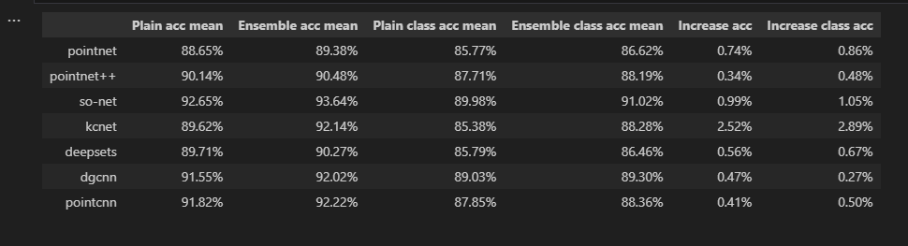
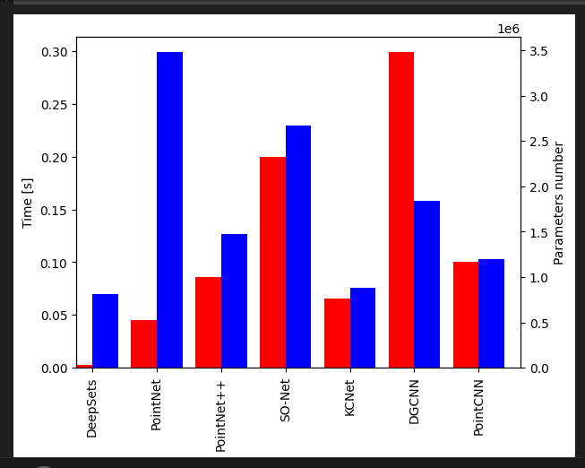
RESULT
The chart compares models for processing point cloud data in 3D classification or segmentation. The x-axis lists DeepSets, PointNet, PointNet++, SO-Net, KCNet, DGCNN, and PointCNN. These models handle unordered point sets and extract features for 3D data processing, advancing analysis techniques.

Slide 7

FUTURE WORK
We are conducting in-depth research on point cloud analysis, exploring various methods and reviewing research papers to enhance understanding, improve algorithms, and develop more efficient processing techniques.

Slide 8
CONCLUTION
point cloud processing plays a crucial role in 3D data analysis, overcoming challenges like irregularity, sparsity, and noise. Various models, including DeepSets, PointNet, and DGCNN, have advanced feature extraction techniques. Our research focuses on enhancing these methods through adaptive sampling, multi-scale feature extraction, and graph-based learning. By conducting in-depth studies and reviewing existing works, we aim to refine algorithms and develop more efficient process.

Slide 9
Thank you

